Slide 1





PORTFOLIO IN
SYSTEM ADMINISTRATION
Submitted by:
Arnold Ayapana
Submitted to:
David John Cayetano

Slide 2

About
the
Owner
Name: Arnold Ayapana
Age: 22 years old
Course & Year: BSIT 4-2
Subject: System Administration
Hobbies
Sing
Play Guitar
Watch Movies
Likes
To go out w/ friends
To sound trip
Travel

Slide 3
Most Memorable Subject Assessment
by: Arnold Ayapana

Slide 4
COMPILATIONS OF MY ACTIVITIES & ASSESSMENTS
by: Arnold Ayapana

Slide 5
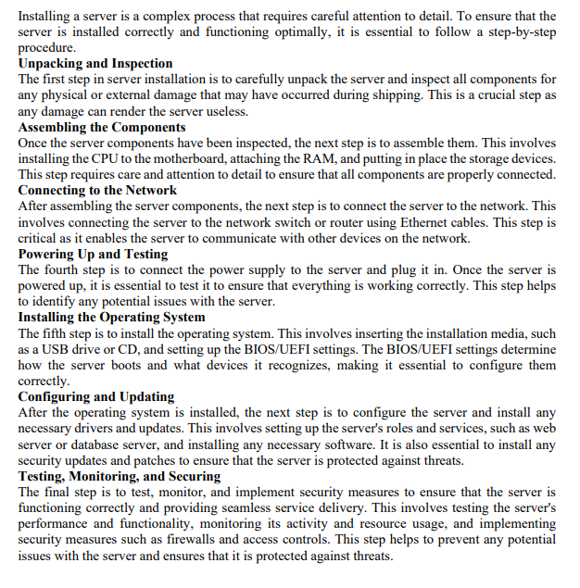
Most Memorable Subject Assessment
Outline the step-by-step process of server installation, covering both the hardware setup and the installation of the operating system. Detail the importance of careful hardware assembly, network connectivity, and power testing to ensure a stable server foundation. Explain the significance of booting from the correct installation media and configuring BIOS/UEFI settings during the OS installation process. Discuss the role of post-installation configurations, driver installations, and updates in ensuring the server is up-to-date and functioning optimally. Lastly, elaborate on the significance of testing, monitoring, and security measures in the server installation process to maintain high performance, protect against threats, and ensure seamless service delivery.

Slide 6
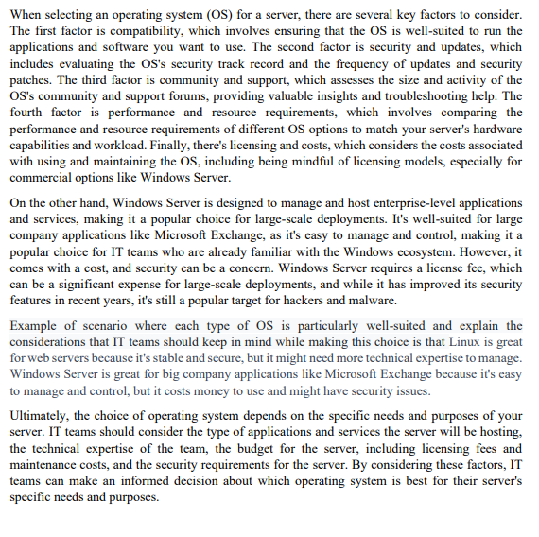
Most Memorable Subject Assessment
Discuss the critical factors that influence the selection of an operating system for a server deployment. Compare and contrast the strengths of various Linux distributions (e.g., Ubuntu Server, CentOS, Debian) and Windows Server in terms of stability, security, compatibility with hardware and applications, and support communities. How do these factors play a role in making an informed decision when choosing an operating system for a specific server's intended purpose? Provide examples of scenarios where each type of OS is particularly well-suited and explain the considerations that IT teams should keep in mind while making this choice.

Slide 7
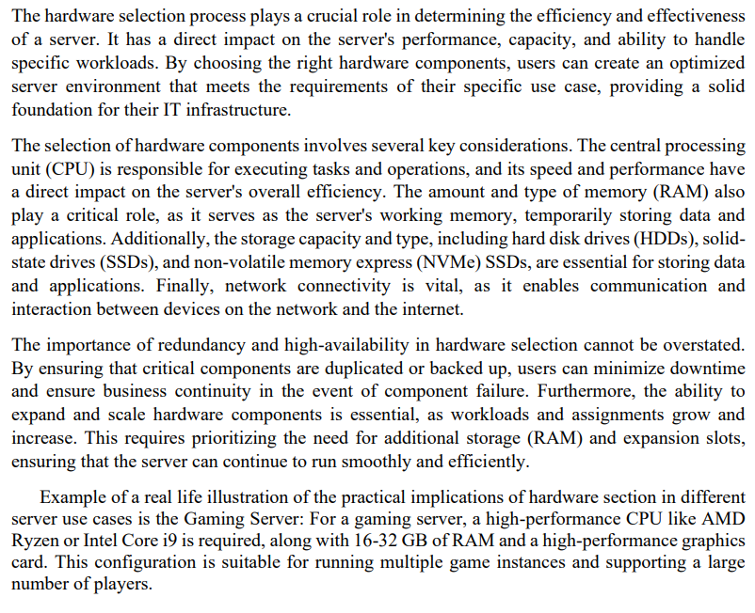
Most Memorable Subject Assessment
Explain the significance of hardware selection in setting up a server, and discuss in detail the factors that need to be considered when choosing server hardware. How do processing power (CPU), memory (RAM), storage capacity, and network connectivity impact the performance and efficiency of a server? Additionally, describe the importance of redundancy and high availability in mission-critical applications and how hardware scalability ensures the server can adapt to future demands. Provide real-world examples to illustrate the practical implications of hardware selection in different server use cases.

Slide 8
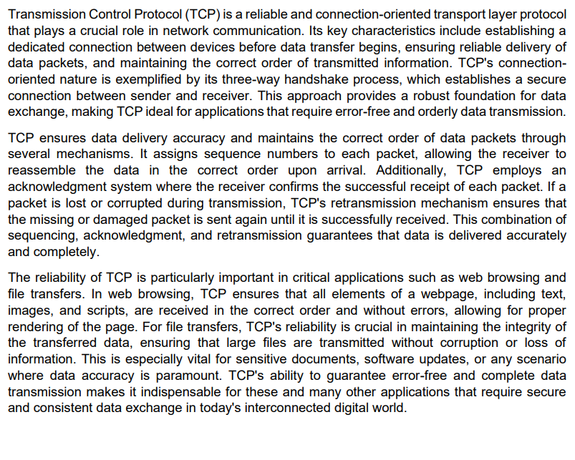
Most Memorable Subject Assessment
Discuss the characteristics and advantages of Transmission Control Protocol (TCP) as a reliable and connection-oriented transport layer protocol. How does TCP ensure data delivery accuracy and maintain the correct order of data packets? Illustrate the importance of TCP's reliability in critical applications like web browsing and file transfers

Slide 9
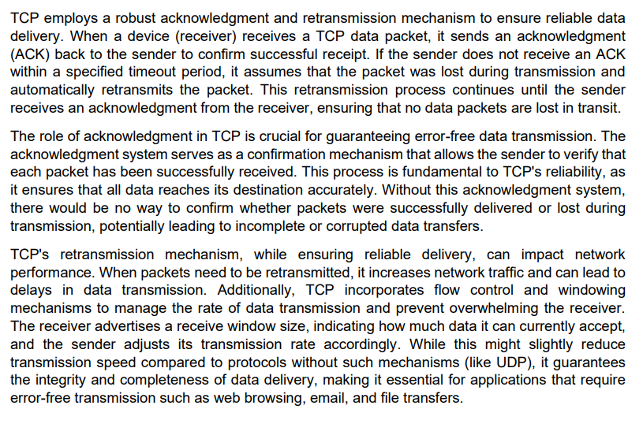
Most Memorable Subject Assessment
Describe the mechanisms employed by TCP for acknowledgment and retransmission of data packets. How does TCP ensure that lost or corrupted packets are retransmitted and received successfully? Discuss the role of acknowledgment in guaranteeing error-free data transmission and the impact of retransmission on network performance.

Slide 10
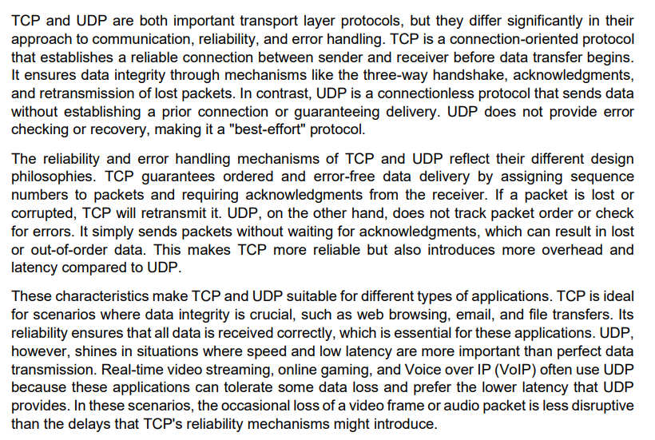
Most Memorable Subject Assessment
Compare and contrast TCP and User Datagram Protocol (UDP) as two widely used transport layer protocols. Discuss the key differences in their communication approach, reliability, and error handling mechanisms. Explain the scenarios where TCP is more suitable, and those where UDP shines, considering applications like real-time video streaming, online gaming, and voice over IP (VoIP).

Slide 11
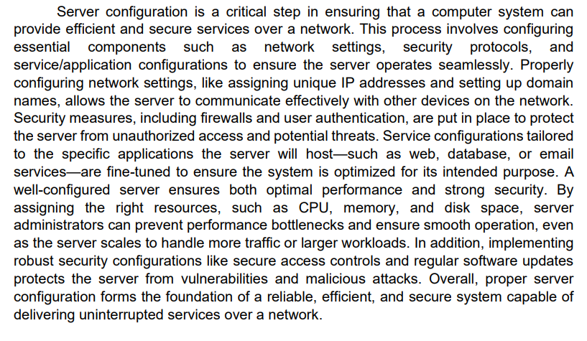
Most Memorable Subject Assessment
Describe the server configuration requirements for hosting different types of services and applications. Choose three server roles, such as web server, database server, and email server, and explain the specific configurations needed for each role to ensure efficient and secure service delivery.

Slide 12
Most Memorable Subject Assessment
Describe the server configuration requirements for hosting different types of services and applications. Choose three server roles, such as web server, database server, and email server, and explain the specific configurations needed for each role to ensure efficient and secure service delivery.

